Slide 1
Verilog (Part 1)
HDL Abstraction
Modern digital design flow
Verilog constructs
Data types
Module
Verilog operators.

Slide 2
HDL Abstraction
Hardware Description Languages (HDL)
HDLs were originally defined to be able to model behavior at multiple levels of abstraction.
Abstraction is an important concept in engineering design because it allows us to specify how systems will operate without getting consumed prematurely with implementation details.
Also, by removing the details of the lower-level implementation, simulations can be conducted in reasonable amounts of time to model the higher-level functionality.

Slide 3
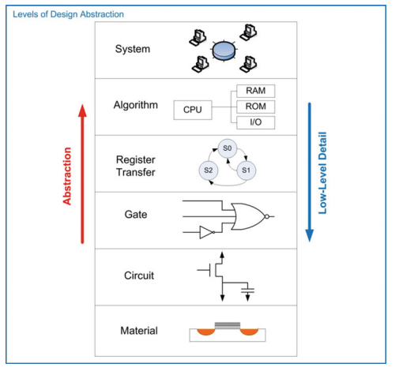

Slide 4
HDL Abstraction
System level
Highest level of abstraction is the system level
Behavior of a system is described by stating a set of broad specifications.
Ex: A specification such as “the computer system will perform 10 Floating Point Operations per Second (10 TFLOPS) on double precision data and consume no more than 100 Watts of power.”
Algorithmic level
Specifications begin to be broken down into sub-systems, each with an associated behavior that will accomplish a part of the primary task.
Ex: computer specifications might be broken down into sub-systems such as a central processing unit (CPU) to perform the computation and random-access memory (RAM) to hold the inputs and outputs of the computation.

Slide 5
HDL Abstraction
Register transfer level (RTL)
Details of how data is moved between and within sub-systems are described in addition to how the data is manipulated based on system inputs.
Gate level
Design is described using basic gates and registers (or storage elements).
Gate level is essentially a schematic (either graphically or text based) that contains the components and connections that will implement the functionality from the above levels of abstraction.

Slide 6
HDL Abstraction
Circuit level
The circuit level describes the operation of the basic gates and registers using transistors, wires, and other electrical components such as resistors and capacitors.
Material level
This level describes how different materials are combined and shaped in order to implement the transistors, devices, and wires from the circuit level.

Slide 7
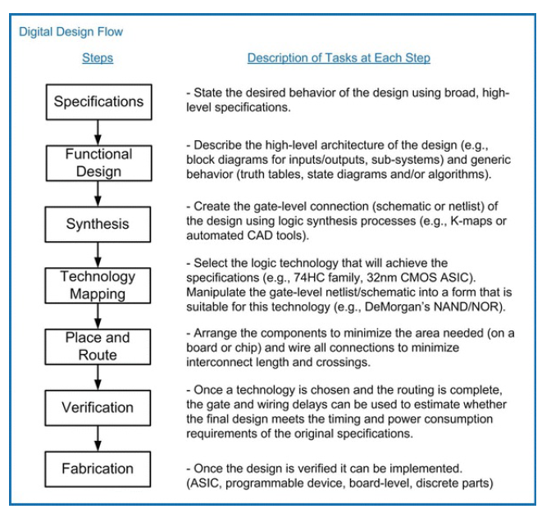
Modern digital design flow

Slide 8
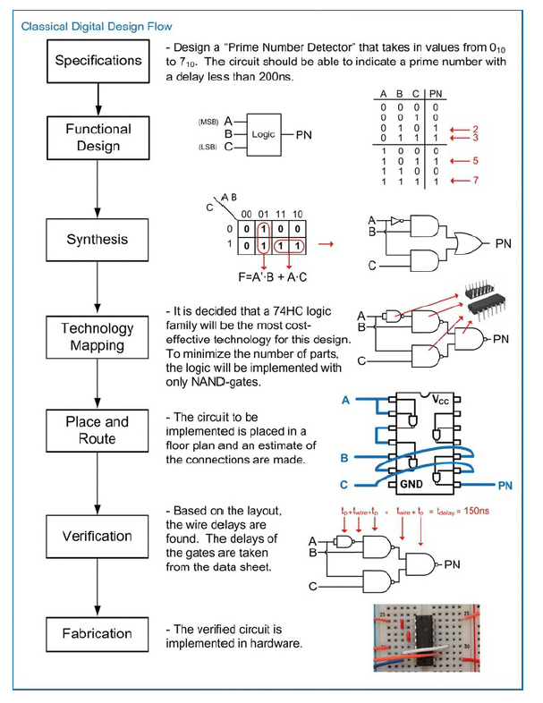

Slide 10
Verilog Constructs
Hardware description languages (HDLs) allow the functionality of digital systems to be entered using text.
VHDL and Verilog are the two most common HDLs in use today.
In the 1980s, two major HDLs emerged, VHDL and Verilog.
VHDL was sponsored by the Department of Defense, while Verilog was driven by the commercial industry.
Both were later standardized by IEEE.

Slide 11
Verilog Constructs

Slide 12
Verilog Constructs
A Verilog design describes a single system in a single file. The file has the suffix *.v.
Within the file, the system description is contained within a module.
The module includes the interface to the system(i.e., the inputs and outputs) and the description of the behavior.
Verilog is case sensitive.
Also, each Verilog assignment, definition, or declaration is terminated with a semicolon (;).
Comments in Verilog are supported in two ways.
Line comment is preceded with two slashes (i.e., //). Everything after the slashes is considered a comment until the end of the line.
Block comment begins with /* and ends with a */. Everything between /* and */ is considered a comment. A block comment can span multiple lines.

Slide 13
Verilog Constructs
All user-defined names in Verilog must start with an alphabetic letter, not a number.
User-defined names are not allowed to be the same as any Verilog keyword.

Slide 14
Data Types
In Verilog, every signal, constant, variable, and function must be assigned a data type.
Value Set
Net Data Types
Variable Data Types
Vectors
Arrays

Slide 15
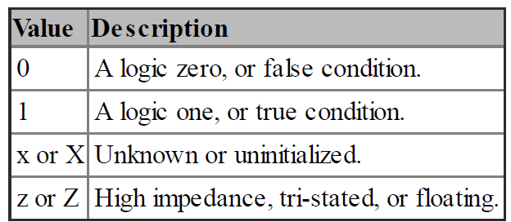
Value Set
Verilog supports four basic values that a signal can take on: 0, 1, X, and Z. Most of the pre-defined data types in Verilog store these values.

Slide 16
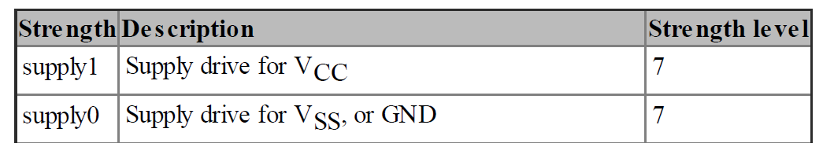
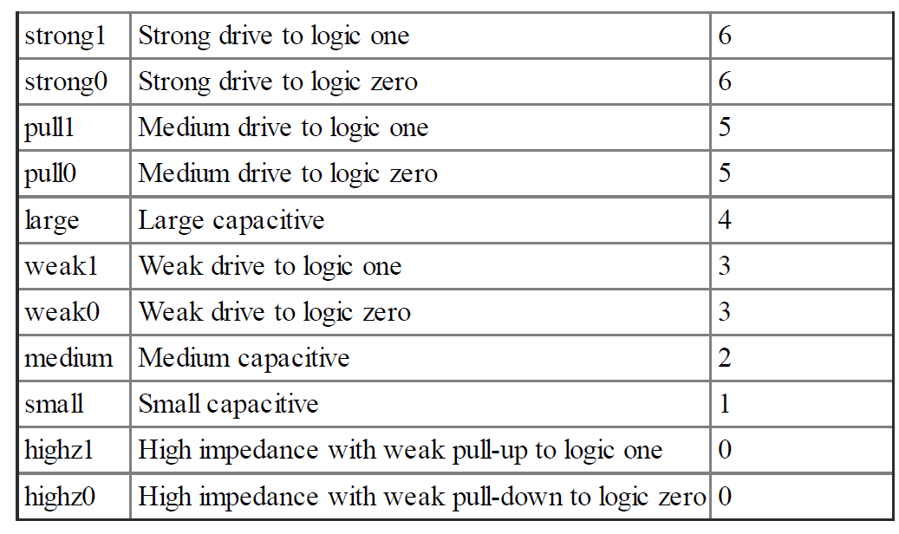
Value Set
In Verilog, these values also have an associated strength.
The strengths are used to resolve the value of a signal when it is driven by multiple sources.
When a signal is driven by multiple drivers, it will take on the value of the driver with the highest strength.
If the two drivers have the same strength, the value will be unknown.
If the strength is not specified, it will default to strong drive, or level 6

Slide 17
Net Data Types
Every signal within Verilog must be associated with a data type.
A net data type is one that models an interconnection between components and can take on the values 0, 1, X, and Z.
A signal with a net data type must be driven at all times and updates its value when the driver value changes.
The most common synthesizable net data type in Verilog is the wire.
Each of these net types can also have an associated drive strength. The strength is used in determining the final value of the net when it is connected to multiple drivers

Slide 18
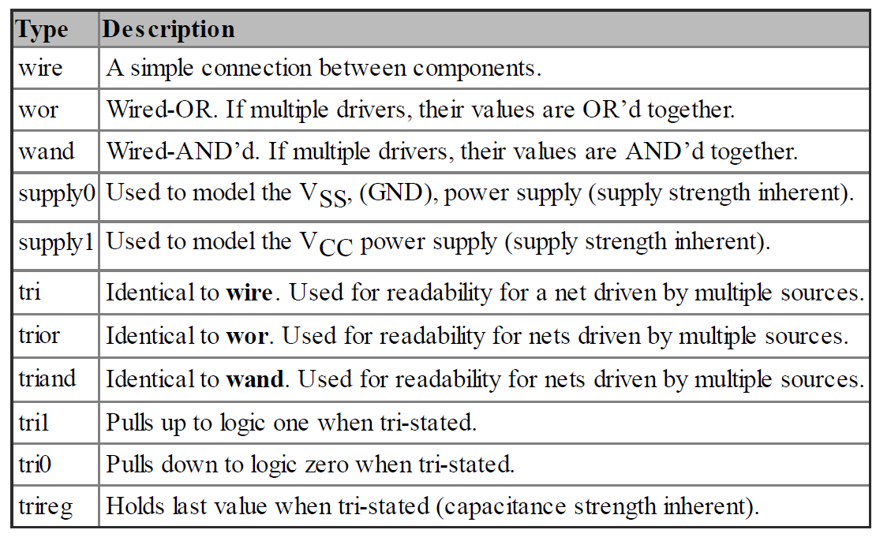
Net Data Types

Slide 19
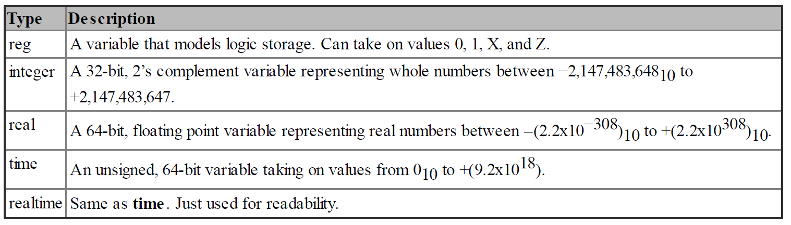
Variable Data Types
Verilog also contains data types that model storage.
These are called variable data types.
A variable data type can take on the values 0, 1, X, and Z but does not have an associated strength.
Variable data types will hold the value assigned to them until their next assignment.

Slide 20
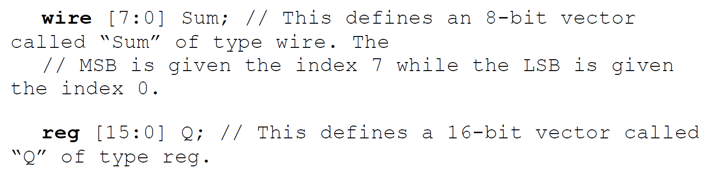
Vectors
In Verilog, a vector is a one-dimensional array of elements. All of the net data types, in addition to the variable type reg, can be used to form vectors.

Slide 21
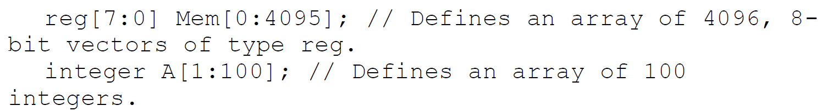
Arrays
An array is a multidimensional array of elements.
This can also be thought of as a “vector of vectors.”
Vectors within the array all have the same dimensions.
To declare an array, the element type and dimensions are defined first followed by the array name and its dimensions.

Slide 22
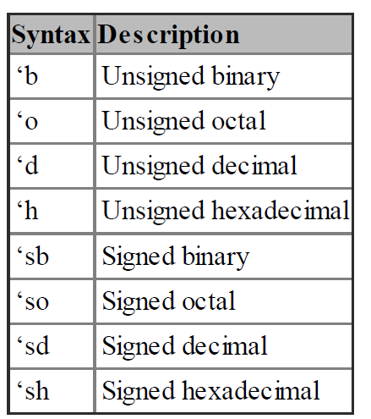
Expressing Numbers Using Different Bases

Slide 23
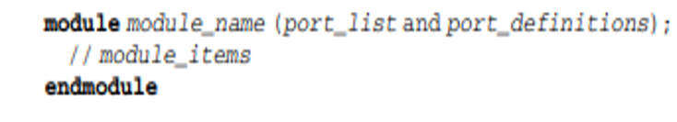
Module
All systems in Verilog are encapsulated inside of a module.
Modules can include instantiations of lower-level modules in order to support hierarchical designs.
The keywords module and endmodule signify the beginning and end of the system description.
When working on large designs, it is common practice to place each module in its own file with the same name.

Slide 24
Port Definitions
The first item within a module is its definition of the inputs and outputs, or ports.
Each port needs to have a user-defined name, a direction, and a type.
The user-defined port names are case sensitive and must begin an alphabetic character.
The port directions are declared to be one of the three types: input, output, and inout.
A port can take on any of the previously described data types, but only wires, registers, and integers are synthesizable.
Port names with the same type and direction can be listed on the same line separated by commas.

Slide 25
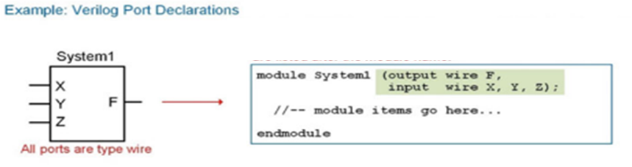
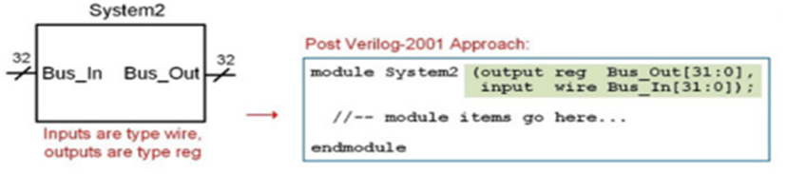
Port Definitions

Slide 26
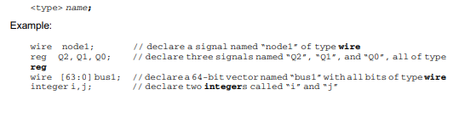
Signal Declarations
A signal that is used for internal connections within a system is declared within the module before its first use.
Each signal must be declared by listing its type followed by a user-defined name.
Signal names of like type can be declared on the same line separated with a comma.
All of the legal data types described above can be used for signals; however, only types net, reg, and integer will synthesize directly.

Slide 27

Parameter Declarations
A parameter, or constant, is useful for representing a quantity that will be used multiple times in the architecture. The syntax for declaring a parameter is as follows:
The type is optional and can only be integer, time, real, or realtime.
If a type is provided, the parameter will have the same properties as a variable of the same time.
If the type is excluded, the parameter will take on the type of the value assigned to it.

Slide 28
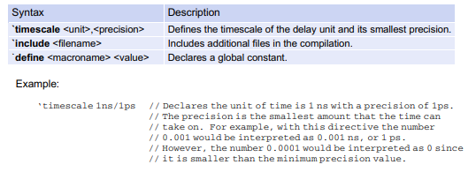
Compiler Directives
A compiler directive provides additional information to the simulation tool on how to interpret the Verilog model.
A compiler directive is placed before the module definition and is preceded with a backtick (i.e., `). Note that this is not an apostrophe.

Slide 29
Verilog Operators
Assignment Operator
Bitwise Logical Operators
Reduction Logic Operators
Boolean Logic Operators
Relational Operators
Conditional Operators
Concatenation Operator
Replication Operator
Numerical Operators

Slide 30

Assignment Operator
Verilog uses the equal sign (=) to denote an assignment.
The left-hand side (LHS) of the assignment is the target signal.
The right-hand side (RHS) contains the input arguments and can contain both signals, constants, and operators

Slide 31
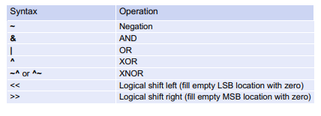
Bitwise Logical Operators
Bitwise operators perform logic functions on individual bits.
The inputs to the operation are single bits and the output is a single bit.
In the case where the inputs are vectors, each bit in the first vector is operated on by the bit in the same position from the second vector.
If the vectors are not the same length, the shorter vector is padded with leading zeros to make both lengths equal.

Slide 32
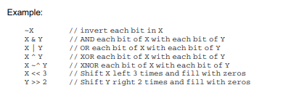
Bitwise Logical Operators

Slide 33
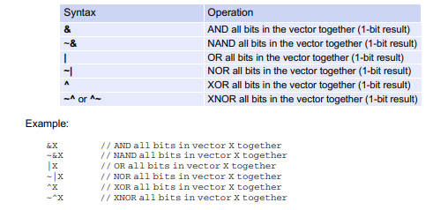
Reduction Logic Operators
A reduction operator is one that uses each bit of a vector as individual inputs into a logic operation and produces a single bit output.

Slide 34
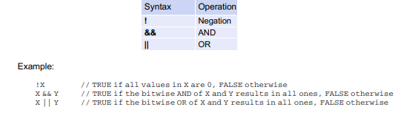
Boolean Logic Operators
A Boolean logic operator is one that returns a value of TRUE (1) or FALSE (0) based on a logic operation of the input operations.

Slide 35
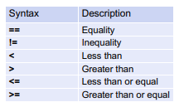
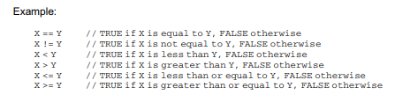
Relational Operators
A relational operator is one that returns a value of TRUE (1) or FALSE (0) based on a comparison of two inputs.

Slide 36
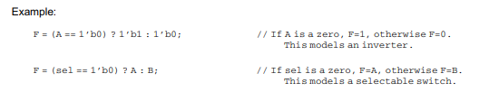
Conditional Operators
Verilog contains a conditional operator that can be used to provide a more intuitive approach to modeling logic statements. The keyword for the conditional operator is ? with the following syntax:

Slide 37
Conditional Operators
This operator specifies a Boolean condition in which if evaluated TRUE, the true_assignment will be assigned to the target.
If the Boolean condition is evaluated FALSE, the false_assignment portion of the operator will be assigned to the target.
The values in this assignment can be signals or logic values.

Slide 38
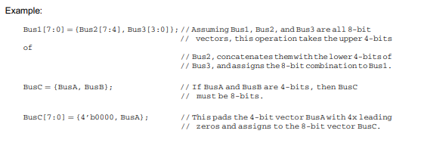
Concatenation Operator
In Verilog, the curly brackets (i.e., {}) are used to concatenate multiple signals. The target of this operation must be the same size of the sum of the sizes of the input arguments.

Slide 39
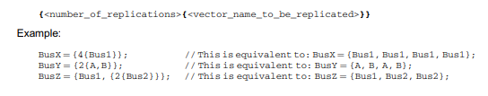
Replication Operator
Verilog provides the ability to concatenate a vector with itself through the replication operator. This operator uses double curly brackets (i.e., {{}}) and an integer indicating the number of replications to be performed.

Slide 40
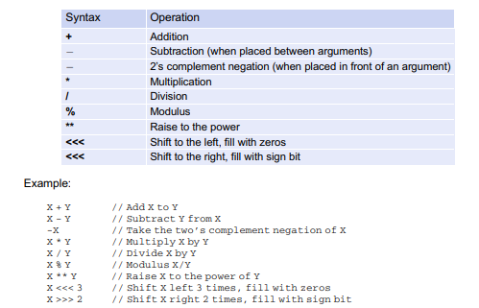
Numerical Operators

Slide 41
Verilog Operators
Verilog will allow the use of these operators on arguments of different sizes, types, and signs.
The rules of the operations are as follows:
If two vectors are of different sizes, the smaller vector is expanded to the size of the larger vector.
If the smaller vector is unsigned, it is padded with zeros.
If the smaller vector is signed, it is padded with the sign bit.
If one of the arguments is real, then the arithmetic will take place using real numbers.
If one of the arguments is unsigned, then all arguments will be treated as unsigned.

Slide 42
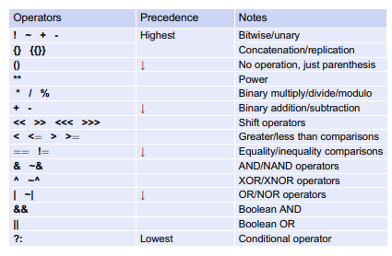
Operator Precedence

